Slide 1
Digital Computer Design
Sequencing and Control

Slide 2
Topics
Control unit
Multiplier as example
hardwired control
microprogrammed control

Slide 3
Control Units
Two types
Programmable
Non-programmable
Look at non-programmable first
A multiplier

Slide 4
Algorithmic State Machines
Like a flowchart to express hardware algorithms
ASM describes sequence of events and timing relationships
Can then turn automatically into circuit

Slide 5
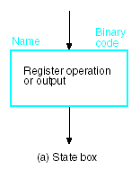
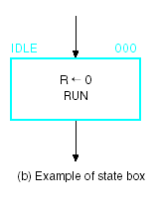
Components (3 of them)
State box specifies a state
And what register ops and/or outputs happen when in this state

Slide 6
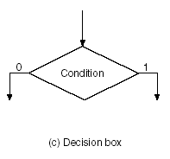
Decision Box
Based on a single variable
Paths for 0 and 1

Slide 7
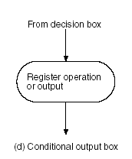
Conditional Output
Register operation is executed if box is reached after decision

Slide 8
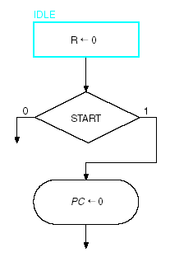
Example
Somewhat like start of CPU

Slide 9
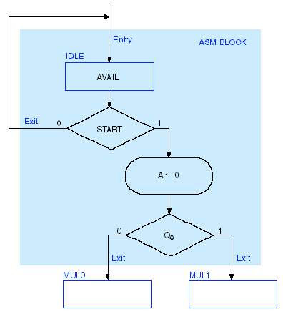
ASM Block
Another example
Machine idle until START
Then A set to 0
Decision based on Q₀

Slide 10
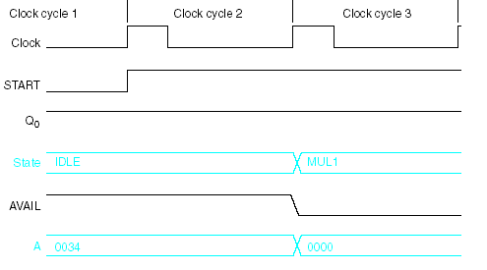
Timing
States change at clock (this is posedge clocked)

Slide 11
Example: Binary Multiplier
Two versions
Hardwired control
Microprogrammed
Multiplies two unsigned binary numbers

Slide 12
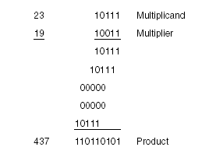
Multiplication Algorithm
Either select multiplicand or zero
Shift left one every time
Sum all to get product
Result size 2n

Slide 13
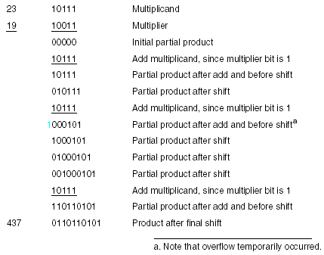
Hardware-Friendly Variation
Partial product
Right shift
Only n bit adder instead of 2n
Each step either add/shift or just shift

Slide 14
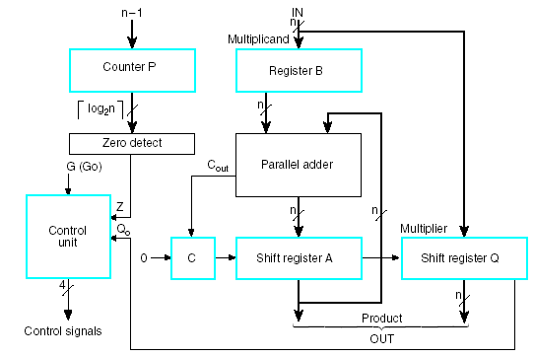
Datapath
Counter size – ceiling of log n
Holds multiplier as well as shifted result. How?

Slide 15

More
Counter preset to n-1. Counts down.
Signals when it hits zero.

Slide 16
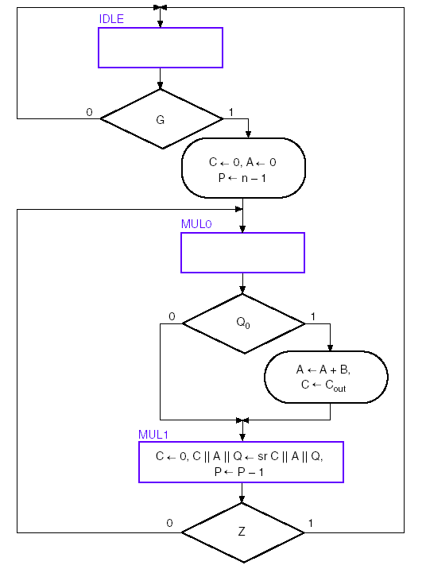
ASM Chart
Look at it in parts

Slide 17
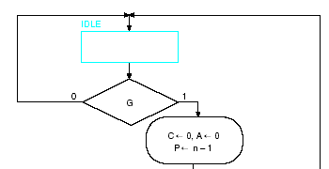
Idle
Wait until G asserted
Then clear C and A, and set P to n-1
Then multiplication begins

Slide 18
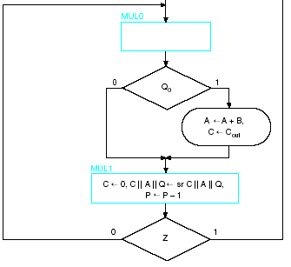
Multiplication
To IDLE
Test Q₀
If 1, add B
Recall that MUL1 done all at same time
What happens to C?
Test counter zero

Slide 19
Hardwired Control
Two aspects to control
Control of the microoperations
Generating signals, such as those for the ALU operations, register numbers, etc.
Sequencing
What happens next?
The order of any microoperations

Slide 20
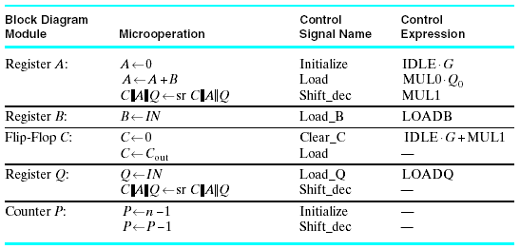
Create Control Sig from ASM
Can look at it one set at a time

Slide 21
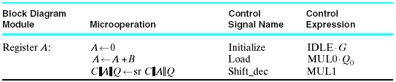
Register A
All microops on Reg A
Last column is combinational expression that controls microop
Name is just assigned by designer

Slide 22

Register B
LOADB is not listed on ASM chart
It’s an external signal that commands reg to load

Slide 23
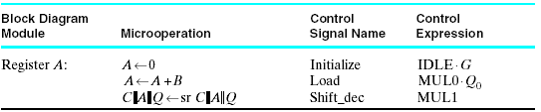
Flip-Flop C
Why is Load repeated?

Slide 24
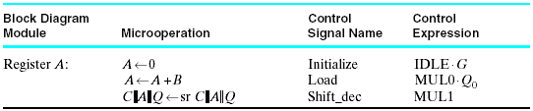
Register Q
Similar
External load
Shift same as for Reg A

Slide 25


Counter P
Both of counter’s Ops happen with others, so no new signals

Slide 26
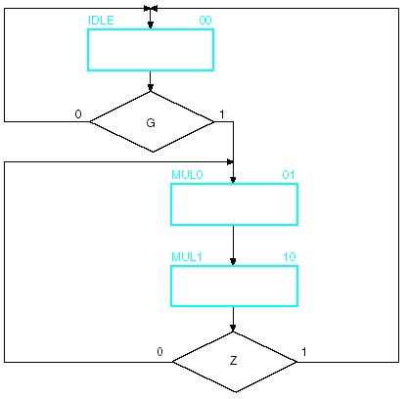
Sequencing
Now can look purely at sequencing
Only decisions affecting next state are left
Q₀ did not affect next state

Slide 27
What We Need to Do
Have decided how to generate control signals
Have separated control from timing
Now: implement in logic

Slide 28
Sequence Register and Decoder
Make register with enough bits to represent states
Add decoder to generate signal for each state
For our example (3 states) need
2-bit register
2-to-4 decoder (only need 3 lines of it)

Slide 29
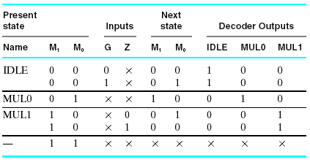
State Table
Let’s recall how this works by stepping through

Slide 30
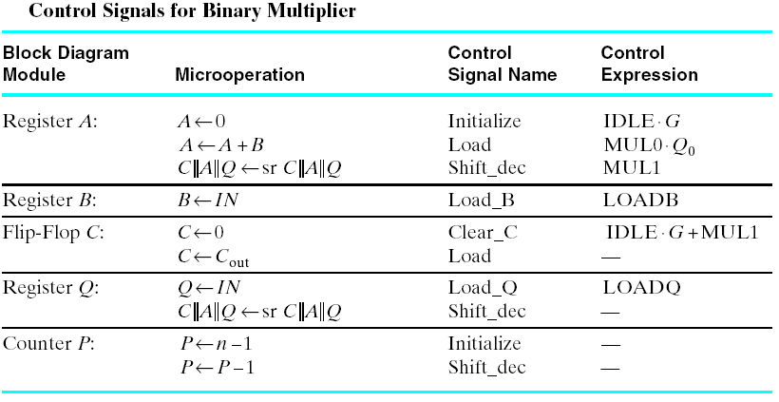
Generate Signals Using Tables

Slide 31
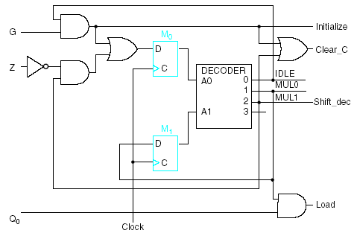


Circuit

Slide 32
One-Hot Encoding
One Flip-Flop per state
Only one of the FFs has value 1
The single 1 propagates, controlled by combinational logic
Seems wasteful at first glance
Need n FFs instead of log n
However, it’s easy to design

Slide 33
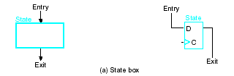
Design from ASM
Just use transformation rules to convert ASM to logic
Here’s state box

Slide 34
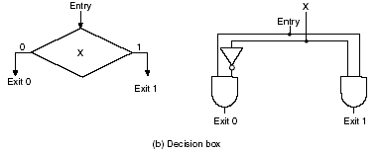
Decision Box
Represents both possibilities

Slide 35

Junction
Junction just an OR gate

Slide 36
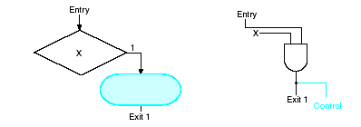
Conditional Output
The action is triggered by the generated control line

Slide 37
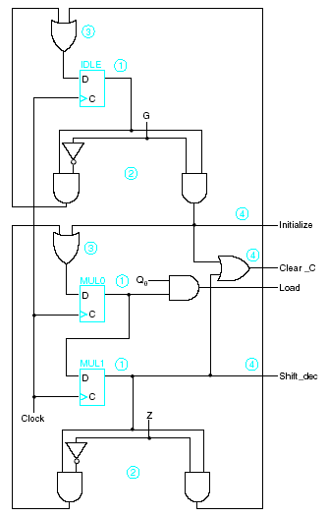
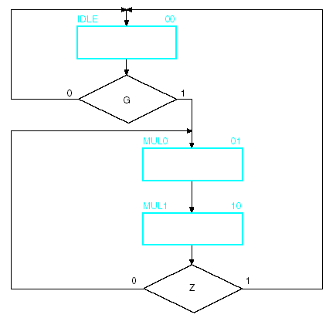
Circuit from Chart
FFs labeled 1, decisions 2, junctions 3, control 4

Slide 38
VHDL Version
Case statement for sequence of states
Transition to next state if criteria are true

Slide 39
_ _Binary Multiplier with n =4: VHDL Description
_ _See Figures 8-6 and 8-7 for block diagram as ASM chart
library ieee;
use ieee. std_logic_1164.all;
use ieee. std_logic_unsigned.all;
entity binary_multiplier is
port (CLK, RESET, G, LOADB, LOADQ: in std_logic;
MULT_IN: in std_logic_vector (3 downto 0);
MULT_OUT: out std_logic_vector (7 downto 0);
end binary_multiplier;

Slide 40
architecture behavior_4 of binary_multiplier is
type state_type is ( IDLE, MULO. MUL1);
signal state, next_state: state_type;
signal A ,B, Q:std _logic_vector (3 downto 0);
signal P: std_logic_vector ( 1 downto 0);
signal C, Z: std_logic;
begin
Z < = P (1) NOR P (0);
MULT_OUT <= A & Q;

Slide 41
state_register: process ( CLK, RESET)
begin
if (RESET = ‘1’) then
state < = IDLE;
elsif (CLK’event and CLK = ’1’) then
state < = next_state;
end if;
end process;

Slide 42
next_state Pfunc: process ( G, Z, state)
begin
case state is
when IDLE =>
if G = ‘1’ then
next_state < = MUL0 ;
else
next_state <= IDLE;
end if;
when MUL0 =>
next _state <= MUL1;
when MUL1 =>
if Z = ‘1’ then
next _state < = IDLE;
else
next_state < = MUL0;
end if;
end case;
end process;

Slide 43
datapath_func: process (CLK)
variable CA: std_ logic_vector (4 downto 0);
begin
if ( CLK’event and CLK = ‘1’) then
if LOADB = ‘1’ then
B < = MULT_IN;
end if;
if LOADQ = ‘1’ then
Q < = MULT_IN;
end if;

Slide 44
case state is
when IDLE =>
if G = ‘1’ then
C< = ‘0’;
A< = “0000”;
P < = “11”;
end if;

Slide 45
when MUL0 = >
if Q (0) ‘1’ then
CA : = ( ‘0’ & A ) + (‘0 & B) ;
else
CA : = C & A;
end if;
C <= CA (4);
A <= CA (3 downto 0);

Slide 46
when MUL1 =>
C < = ‘0’ ;
A < = C & A (3 downto 1);
Q < =A (0) & Q (3 downto 1);
P < = P – “01”;
end case;
end if;
end process;
end behavior_4;

Slide 47
This Set of Slides
We’ve taken an example
Created the ASM
Divided into control and sequencing
Looked at two ways to implement using logic
Looked at VHDL example
Next
Look at microprogrammed control of multiplier

Slide 48
Microprogrammed Approach
Control values stored in a memory
Job of instructions is to generate control signals to datapath and output

Slide 49
Nomenclature and Characteristics
Word of memory called microinstruction
The set of instructions called microprogram
Sometimes in ROM, sometimes loadable
Often wide word

Slide 50
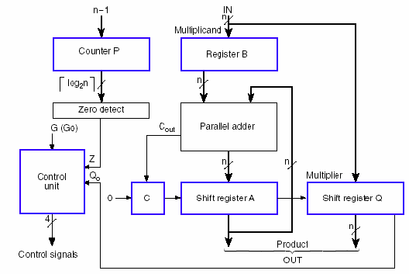
Recall Datapath

Slide 51
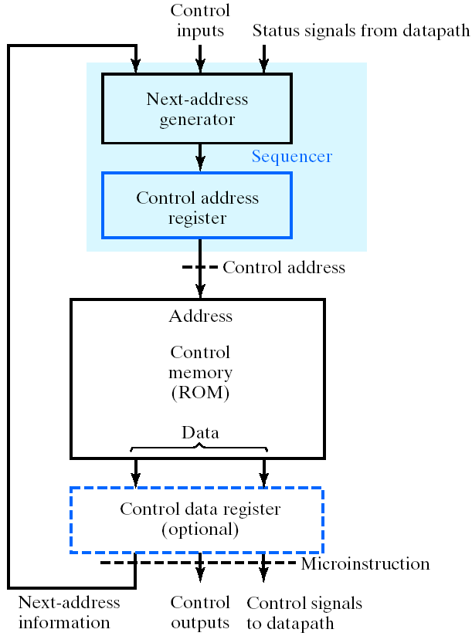
Microprogrammed Control Unit
Control Address Register (CAR) equivalent to PC
Sequencer
Part of instruction sent to next-address generator to determine next instruction addr

Slide 52
Control Data Register
Pipelining approach to break up the delay in the addr gen and ROM
Not used in example

Slide 53
Status Bits
Notice that they go only to sequencer
Can only affect next control word
So, conditional output boxes not allowed in this architecture

Slide 54
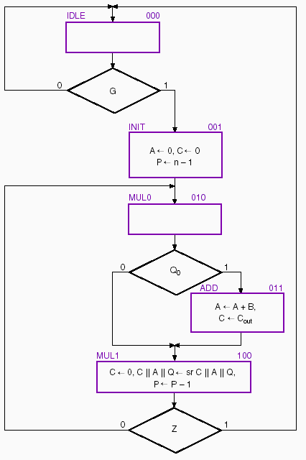
ASM – old vs. new

Slide 55
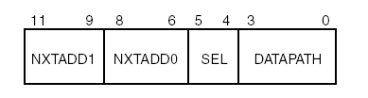
Microinstruction
Word format
Addresses of potential next instructions
Fields for next instruction selection
Fields for datapath control

Slide 56
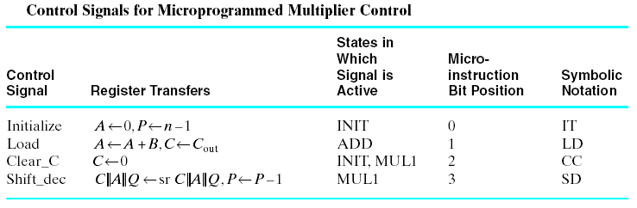
Datapath Control Signals
Doesn’t include load reg inst.
Look at ASM to see where they are asserted

Slide 57

Mapping to Microinstruction
Have only 4 signals
Could encode (2 bits?)
Would cost a decoder
Just a design tradeoff
This design has tiny ROM anyway

Slide 58
Sequencer Design
Probably most important part of this process
This design provides 2 addrs
SEL field and control logic choose one
Other possibility is one addr field
Choice is to go to next sequential addr (like PC), or
Using control signals go to addr specified

Slide 59
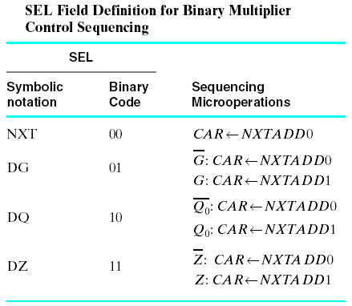
SEL Field

Slide 60
Result
5 words in ROM
ROM is 12 bits wide
Design next

Slide 61
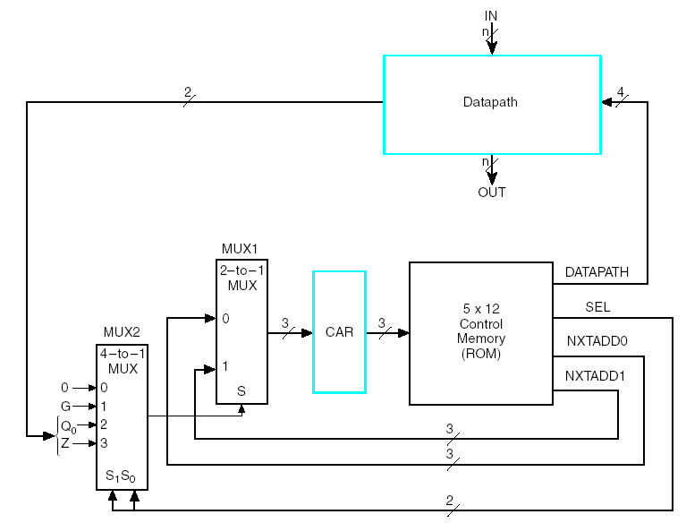
Microprog Design for Mult
Mux chooses addr1 or addr2
Mux control from datapath status and external signals.
Next slide

Slide 62
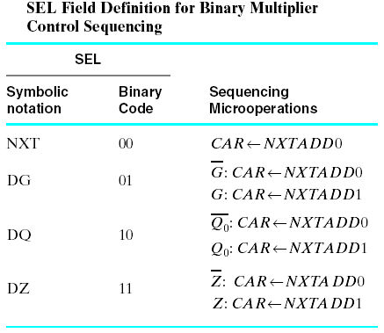
Detail of Control

Slide 63
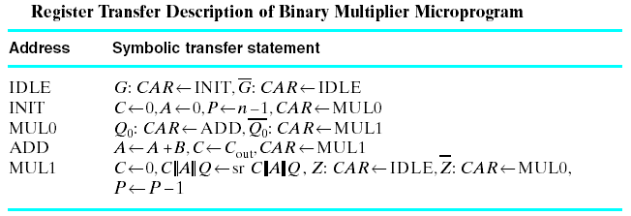
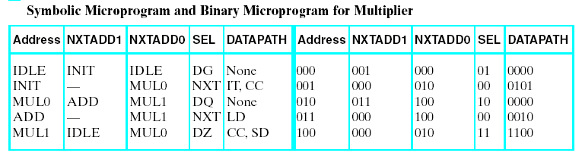
Microprogram

Slide 64
Out of Style
Microprogramming less useful now that HLLs used for design
Can use VHDL to generate very complex state machine

